Slide 1


Slide 2
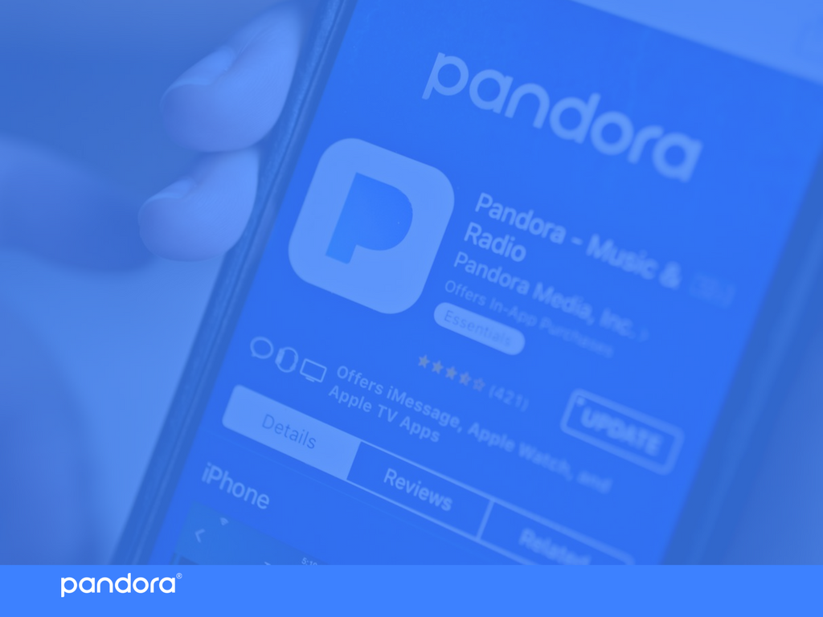
AGENDA
Market Overview → Cailyn
Problem → Valerie
Recommendation → Alastair
Implementation → Tracy
Financial Analysis → Tracy
Summary
2 |

Slide 3
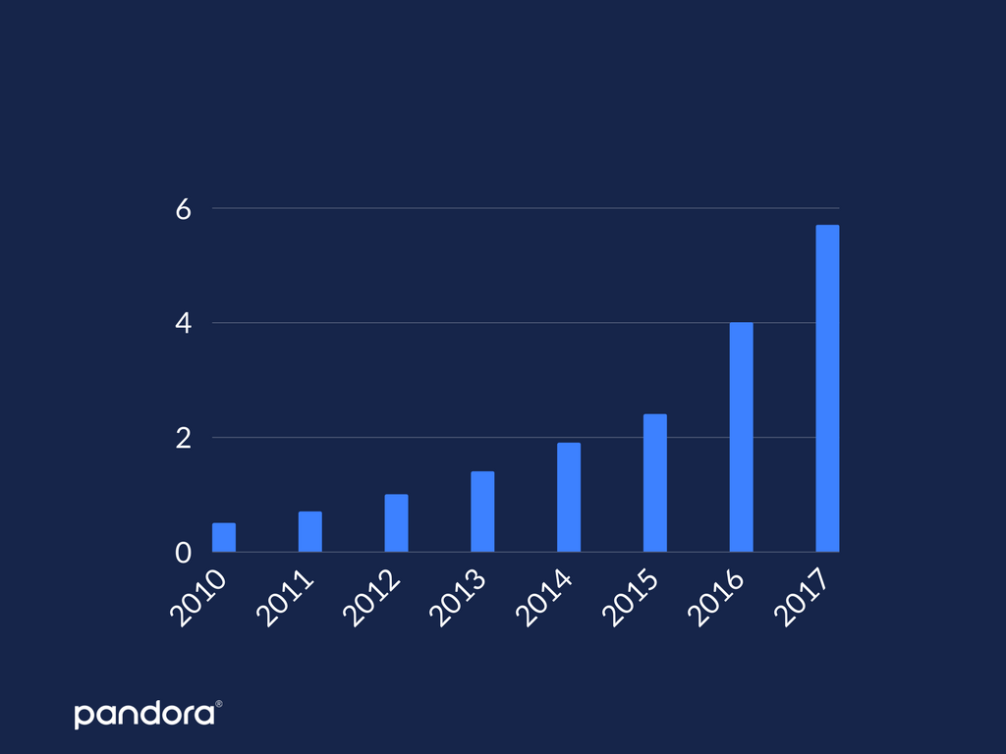
REVENUE FROM MUSIC STREAMING IN U.S. FROM 2010 - 2017
REVENUE IN BILLIONS
YEAR
SOURCE: STATISTA
3 |

Slide 4
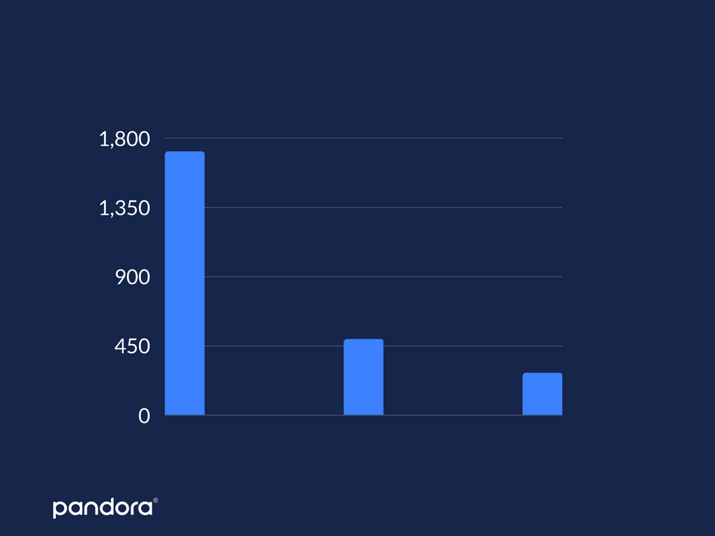
2017 REVENUE FROM MUSIC STREAMING IN U.S. BY SOURCE
REVENUE IN MILLIONS
PAID
SUBSCRIPTION
FREE AD-SUPPORTED
SUBSCRIPTION
DIGITAL
RADIO
SOURCE
SOURCE: STATISTA
4 |

Slide 5

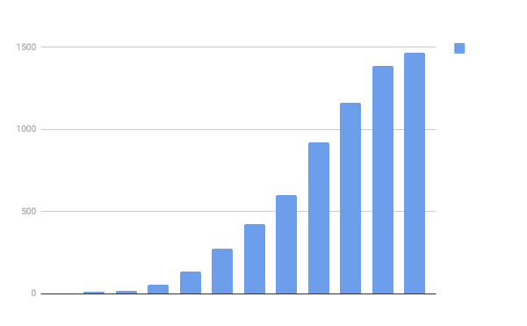
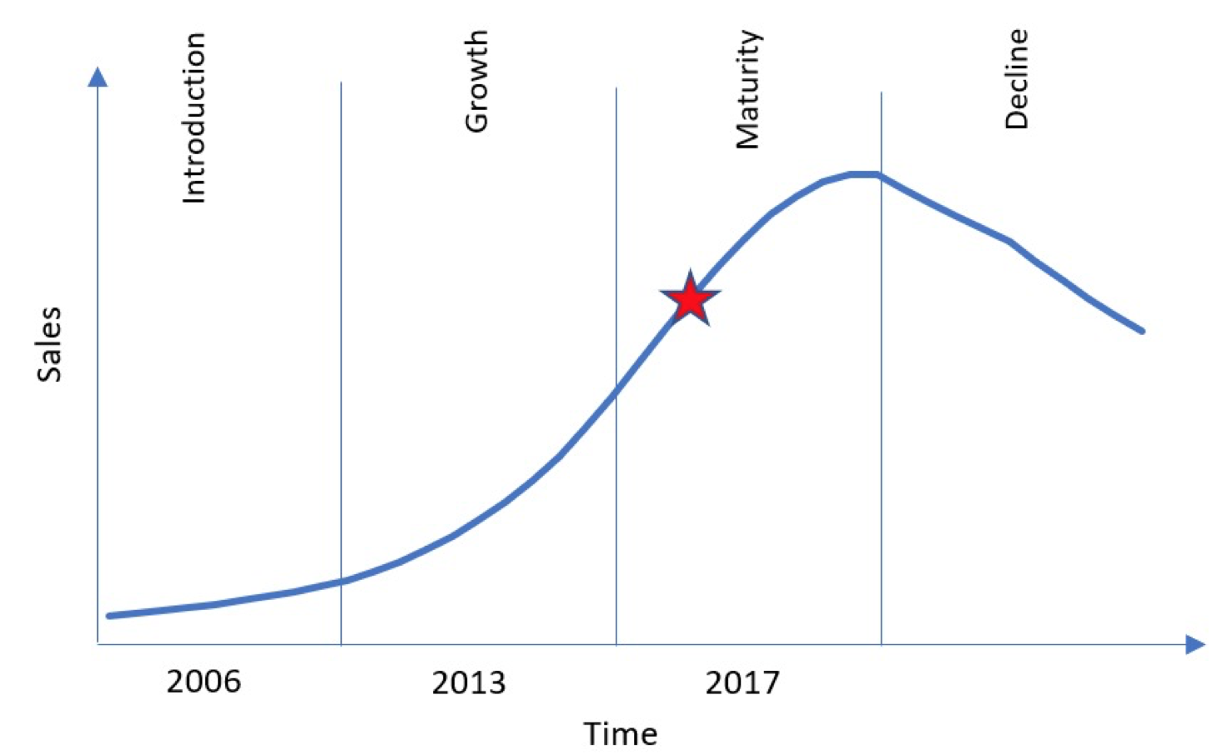
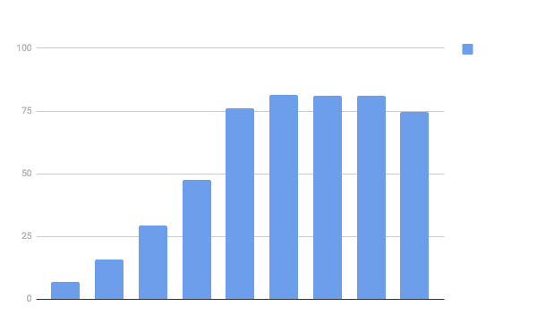

PRODUCT LIFE CYCLE CURVE
5 |

Slide 6
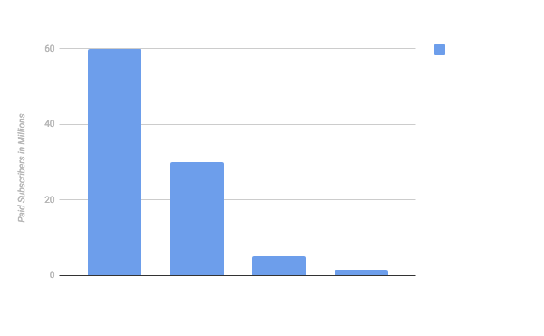
MUSIC STREAMING SUBSCRIBER OVERVIEW
SOURCE: STATISTA
6 |

Slide 7
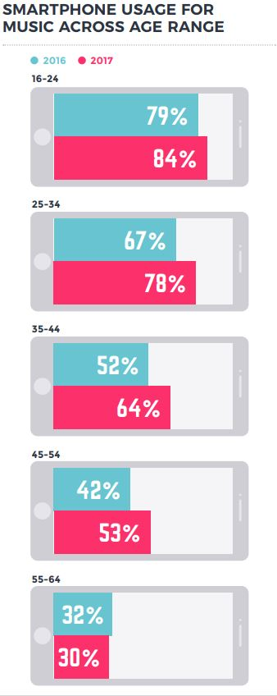

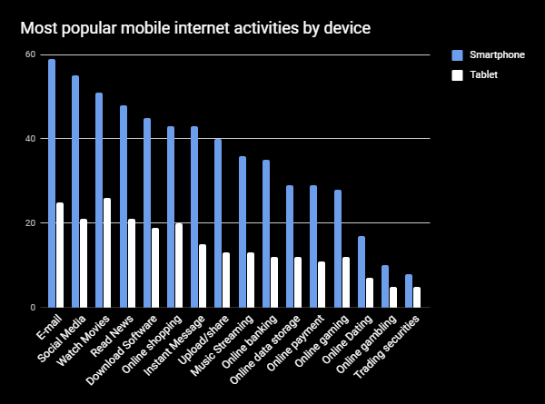
DRIVING FORCE: GROWING SMARTPHONE USAGE
PERCENTAGE OF USERS
MOBILE ACTIVITY
SOURCE: STATiSTA AND IFPI
7 |

Slide 8

DRIVING FORCE: GROWING YOUNGER DEMOGRAPHIC
“13 – 15 year-old internet users are demonstrating high levels of music engagement - giving an insight into the ‘next generation’ of music consumer” - International Federation of the Phonographic Industry
85% OF 13-15 YEAR-OLDS ARE STREAMING MUSIC (AUDIO/VIDEO)
8 |

Slide 9
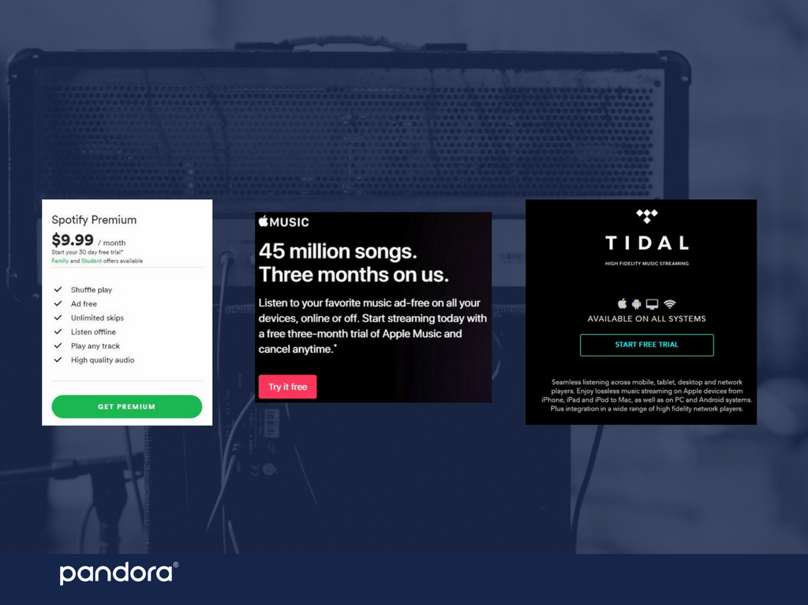
CRITICAL SUCCESS FACTOR: FREE PREMIUM TRIALS
9 |

Slide 10
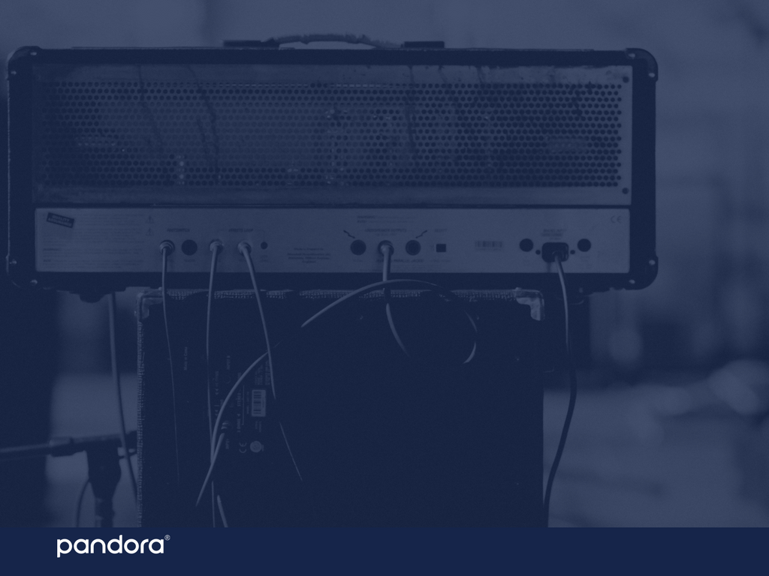
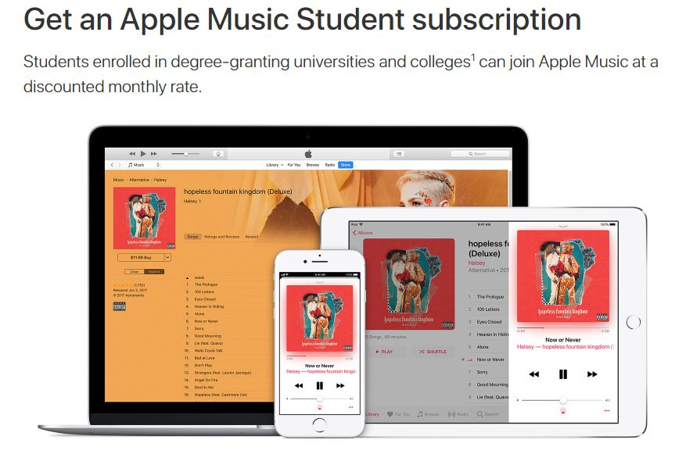
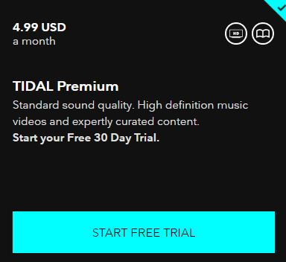
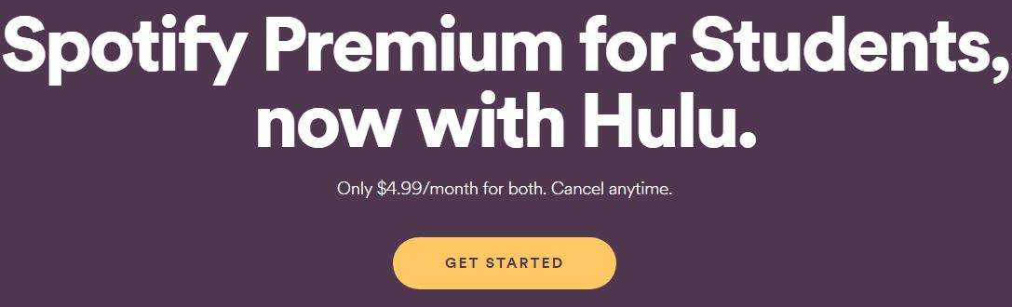
CRITICAL SUCCESS FACTOR: DISCOUNTED PREMIUM OFFERS FOR STUDENTS
10 |

Slide 11
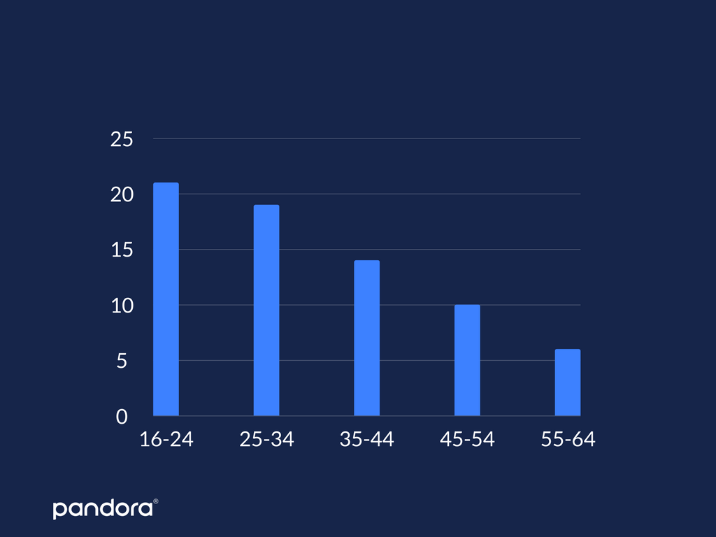
PERCENTAGE OF USERS
AGE
SOURCE: STATISTA
SHARE OF CONSUMERS WHO PAID FOR A MUSIC STREAMING SERVICE BY AGE
11 |

Slide 12
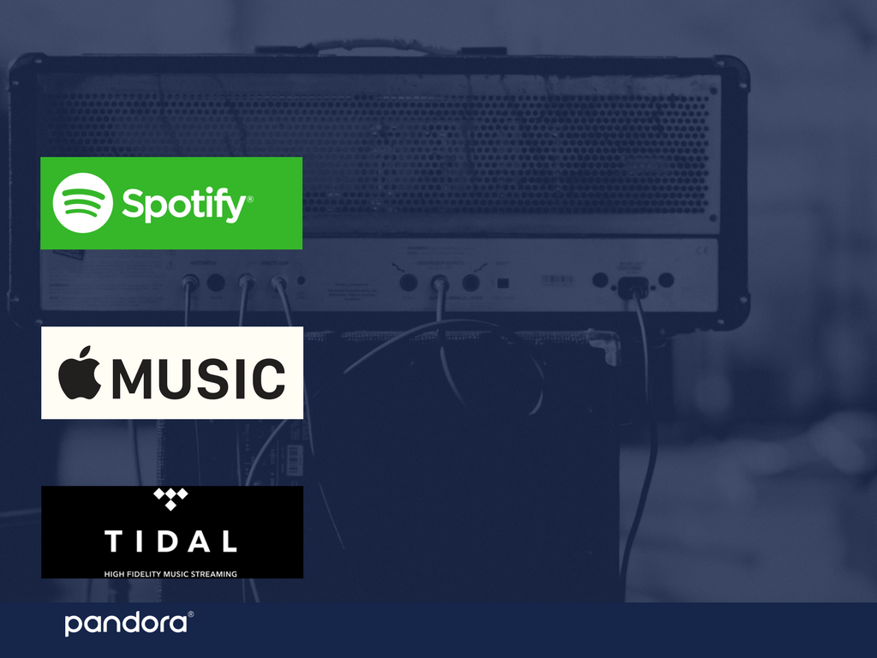
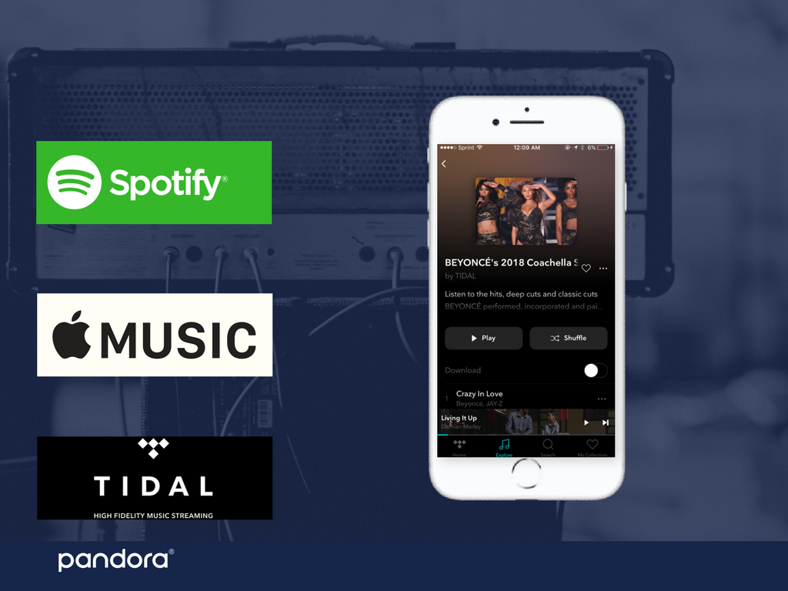
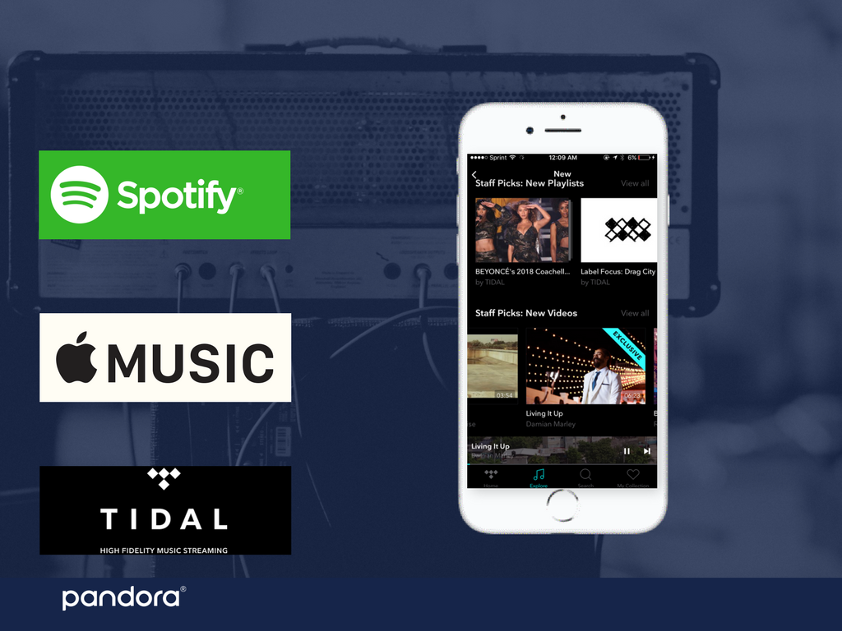
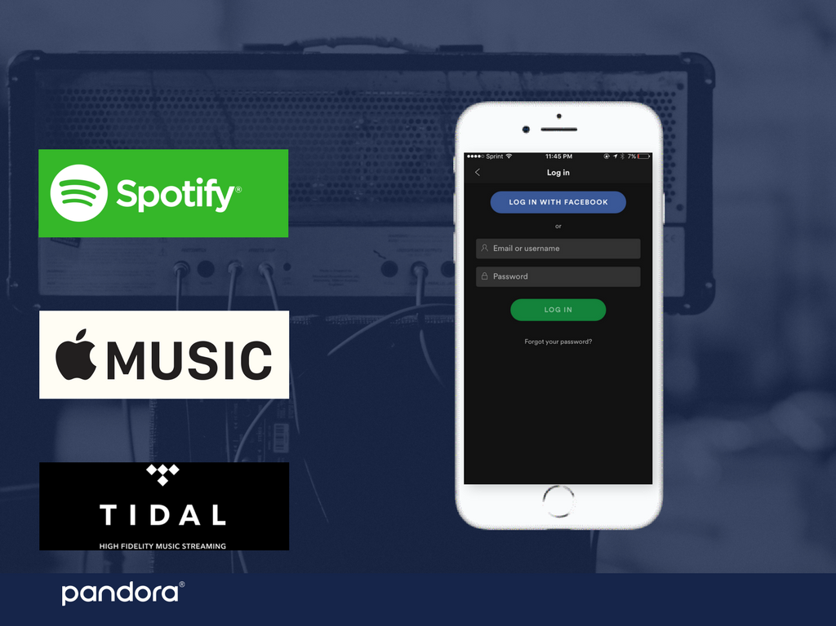
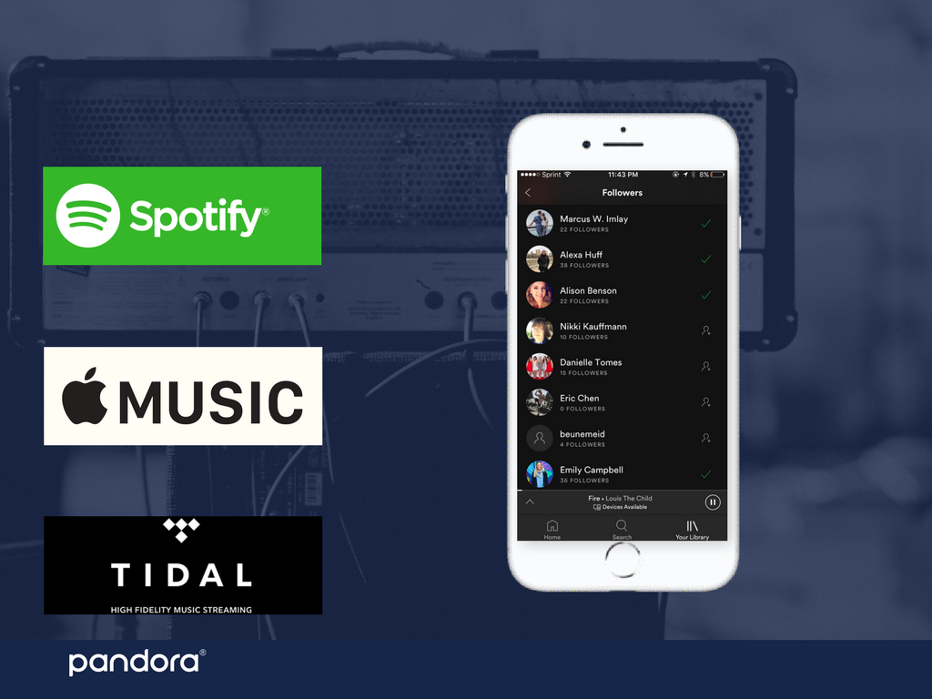
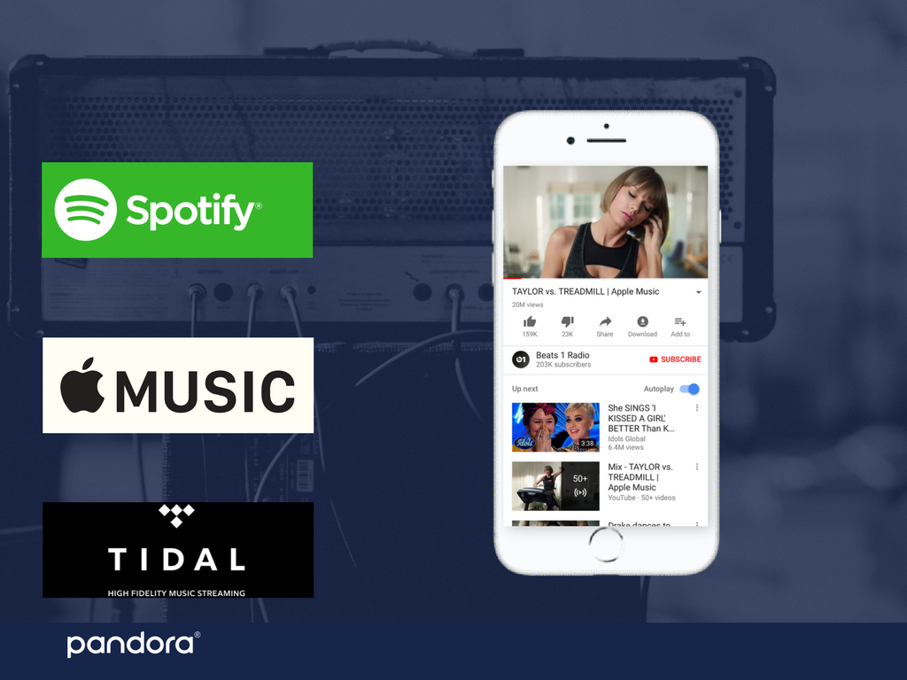
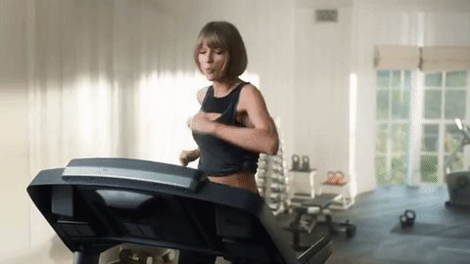
COMPETITORS’ ADVANTAGE
12 |

Slide 13
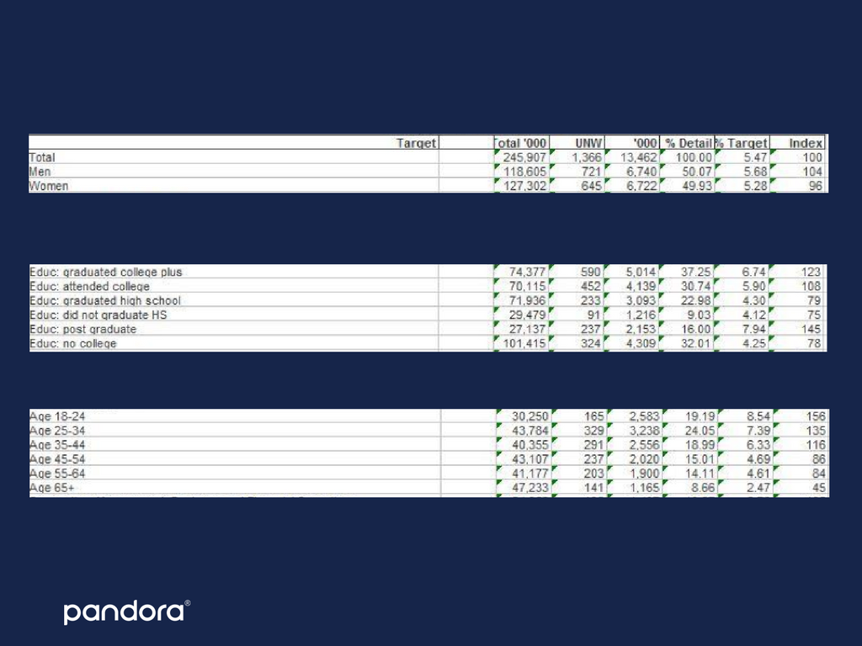
MRI DATA
GENDER
EDUCATION
AGE
13 |

Slide 14

BUYER DESCRIPTION
BASED ON SURVEY DATA - 80 RESPONSES
79% PAID $5 - $10 ON MUSIC STREAMING IN PAST 30 DAYS
74% 18 - 24-YEARS OLD
74% LISTENED TO MUSIC DAILY
68% USE SOCIAL MEDIA ASPECT
54% ARE WILLING TO PAY FOR MUSIC STREAMING
53% COLLEGE STUDENT
14 |

Slide 15
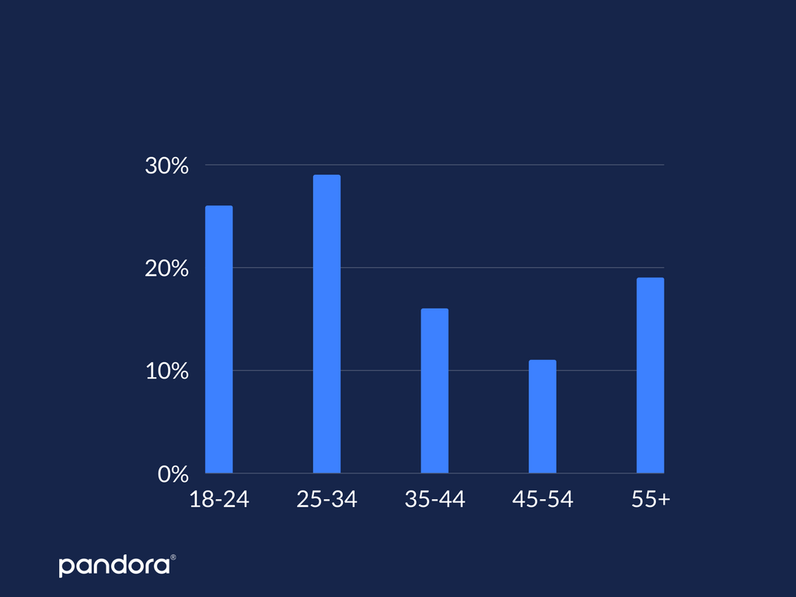
SPOTIFY LISTENERS BY AGE
PERCENTAGE
SOURCE: STATISTA
AGE
15 |
Notes:
26% of Spotify listeners are between 18-24 years old.

Slide 16
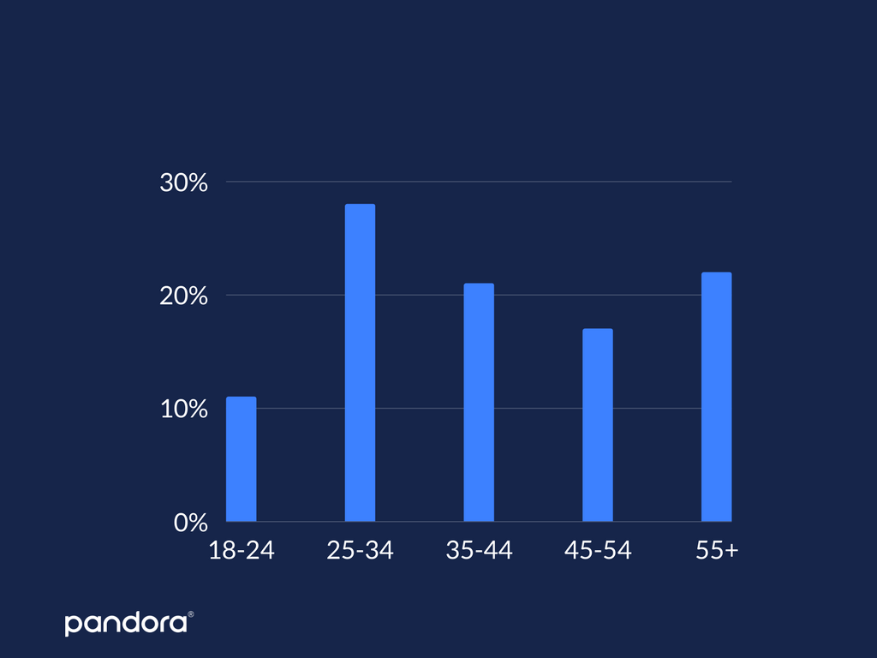
PANDORA LISTENERS BY AGE
PERCENTAGE
SOURCE: STATISTA
AGE
16 |
Notes:
11%

Slide 17
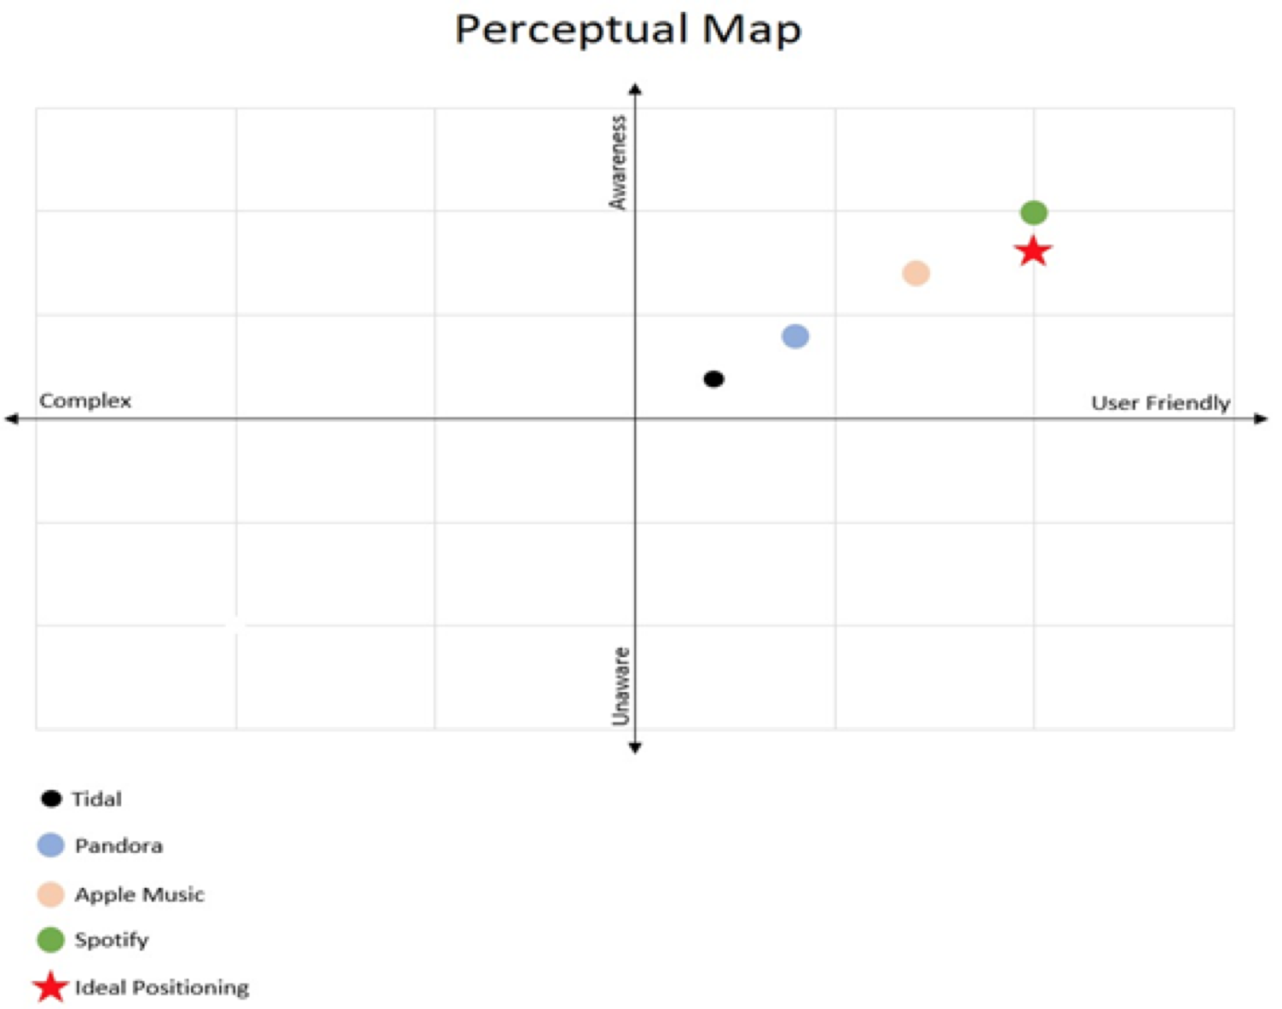
PROBLEM | PERCEIVED VALUE
17 |
Notes:
The major problem facing Pandora is an issue with the perceived value.
According to our survey we did this perceptual map about awareness and user friendly were
Symptons
Spotify is taking the lead.
Struggling for market shares with competitors

Slide 18
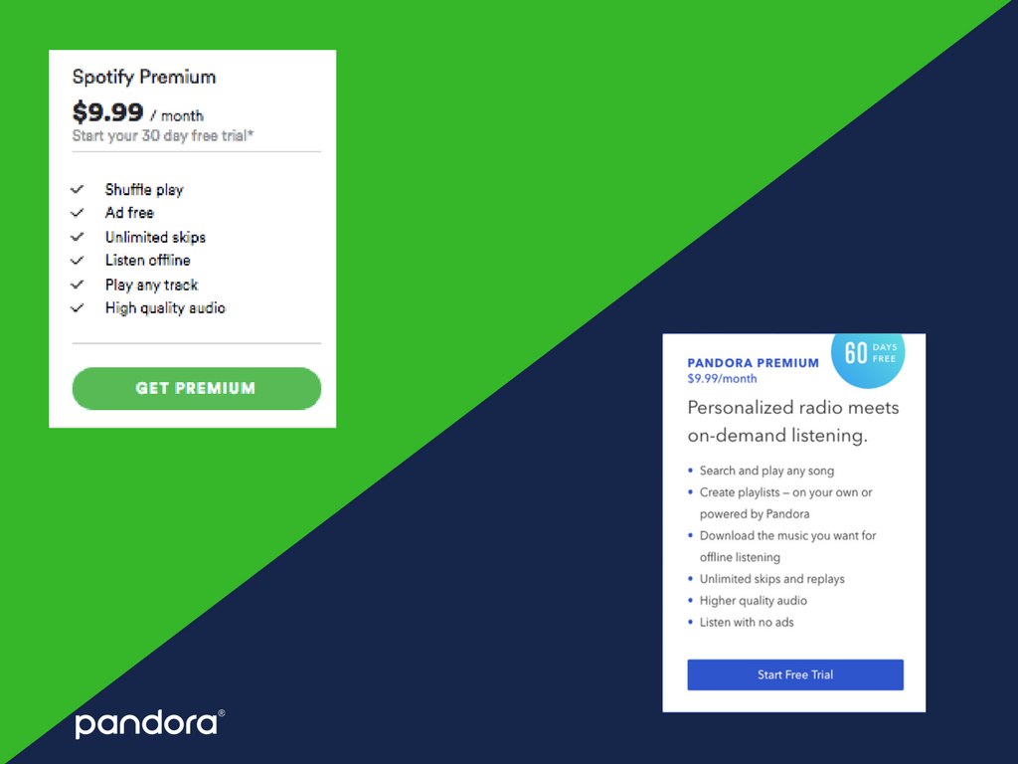
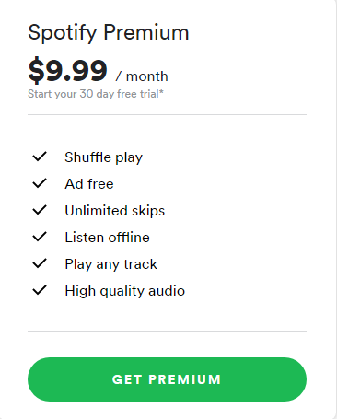
Spotify Student Premium
$4.99
18 |
Notes:
As we can see in our previous slide, Spotify is our major competitor. the reason we think this is a perceived value problem is because, both of their premiums products provide the same features, however Pandora does not have a student discount, and from our industry analysis. We concluded that our buyers are majority college students.
Students do not see the value in Pandora’s product, since Spotify provides Hulu and its premium features for $4.99

Slide 19
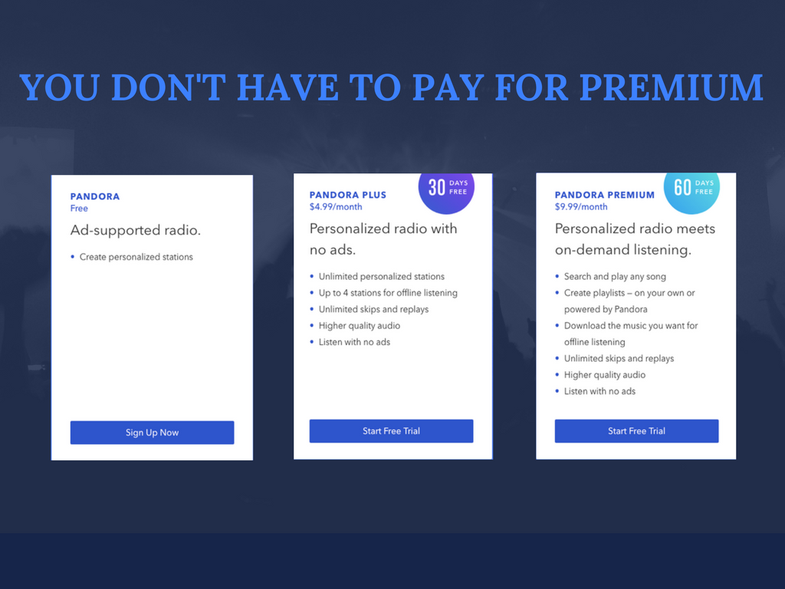

19|

Slide 20
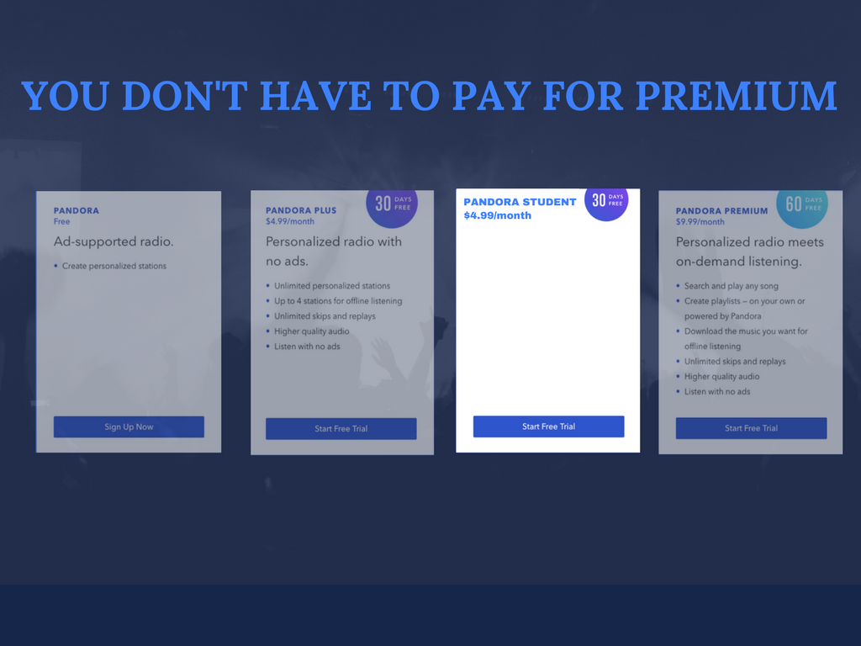
Personalized radio meets on-demand listening FOR STUDENTS
Search and play any song
Create playlists — on your own or powered by Pandora
Download the music you want for offline listening
Unlimited skips and replays
Rewards program
-
20 |

Slide 21
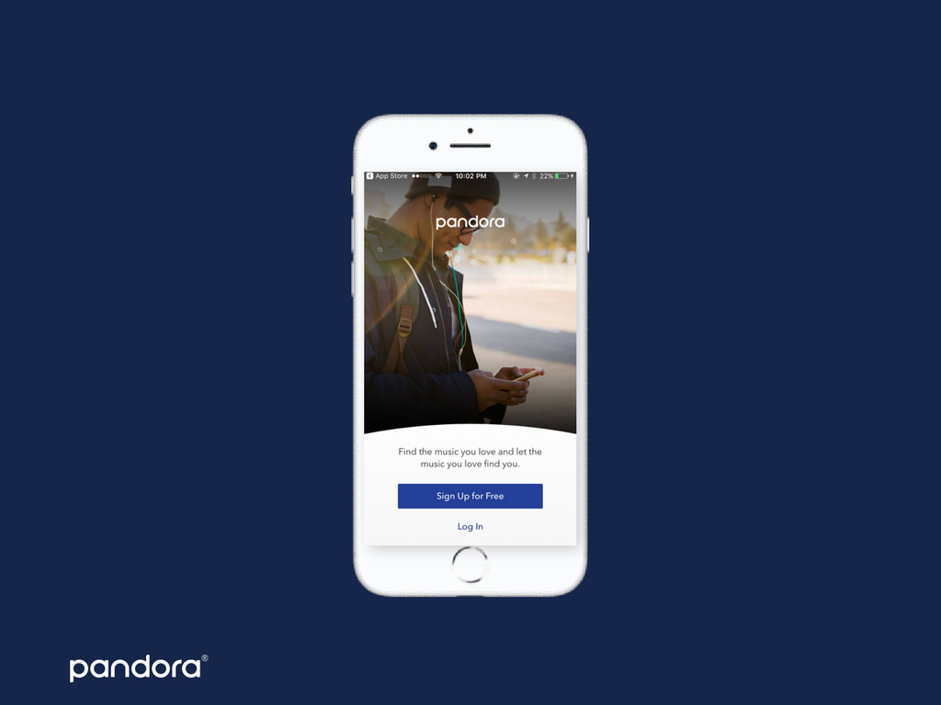
21 |

Slide 22
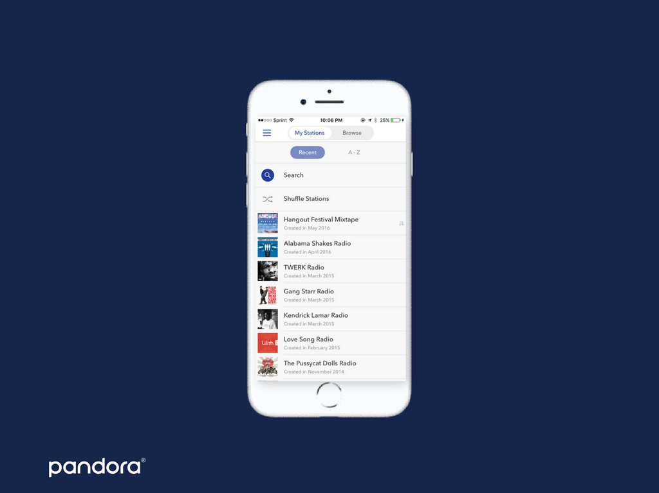
22 |

Slide 23
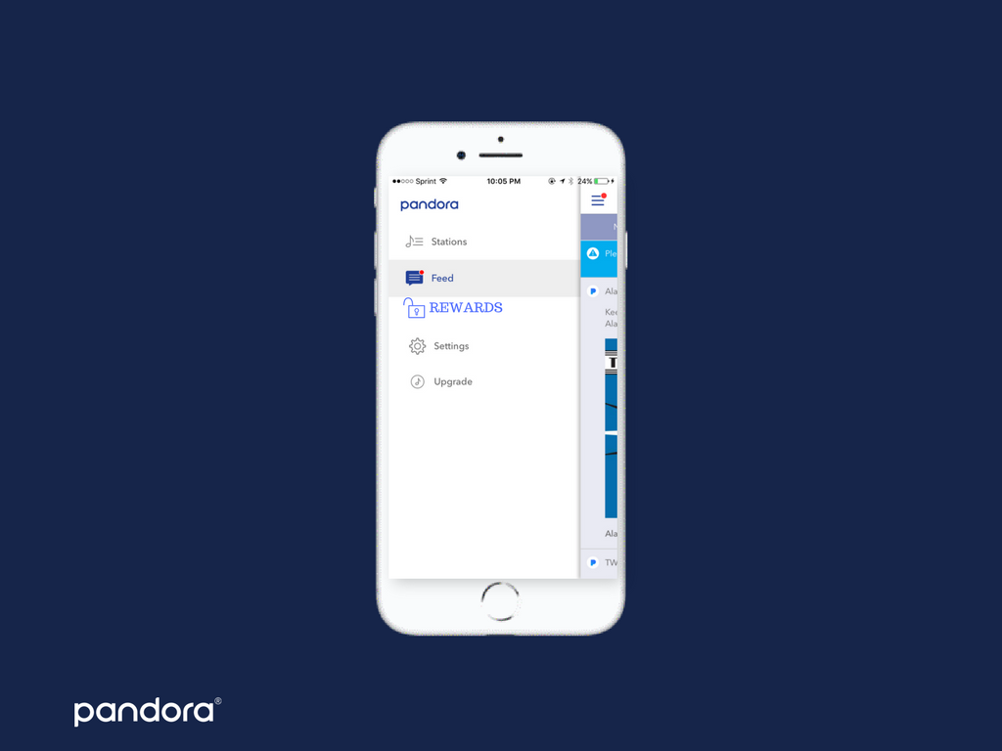
23 |

Slide 24
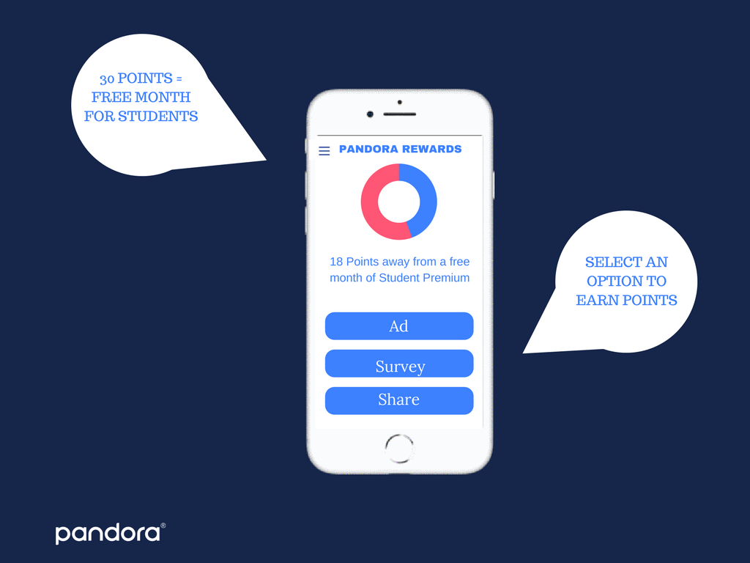
24 |

Slide 25

PANDORA PREMIUM
$9.99
PANDORA STUDENT
PANDORA PLUS
$4.99
$4.99
25 |
Notes:
Action plan (college discount-Pandora Plus (no change in price) or upgrade to Pandora Premium and get the first month free (graduation gift).
Reward system points

Slide 26
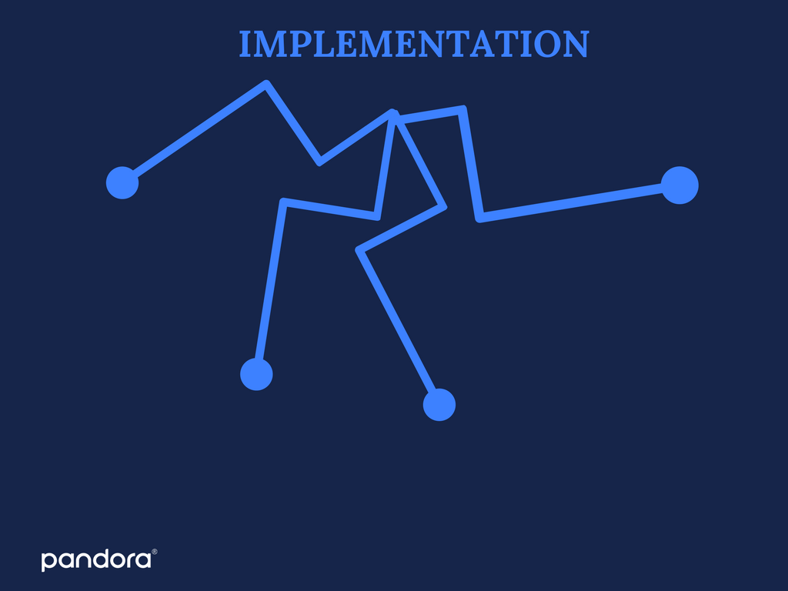
Quarter 1
Quarter 4
Send a user wide marketing campaign urging all college students to sign up for the $4.99 student discount.
Realistically a 21.5% increase in new user subscription revenue over the course 1 year time span.
Quarter 2
Quarter 3
Infographic of how to get free services through referral program, loyalty services, or watching paid advertisement through Pandora’s platform advertising.
Survey to all new users to gauge perspective on the target segment and to find out likes/dislikes of the platform and its services.
26 |

Slide 27
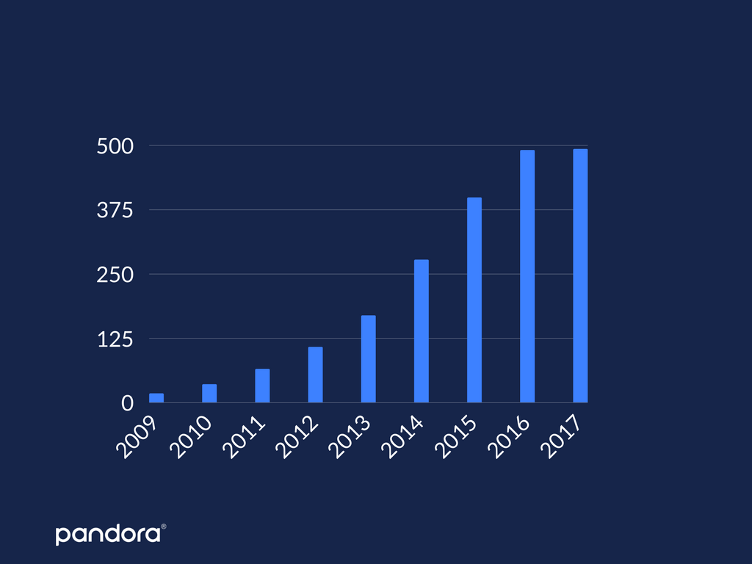
Spending in Millions
Year
SOURCE: STATISTA
FINANCIAL METRICS
27 |

Slide 28

COSTS
ROI
BREAKEVEN
7 Months
$(28.5-15)/15M = 90%
$15 Million
28 |

Slide 29
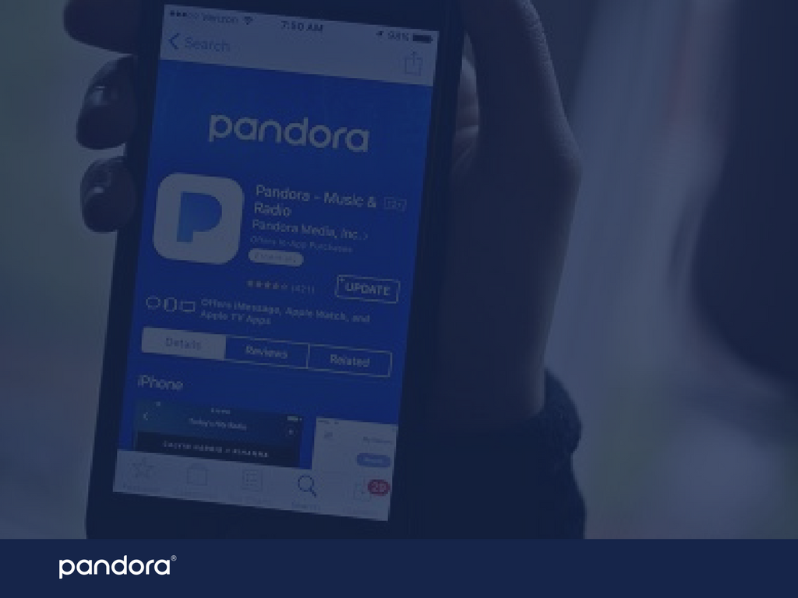
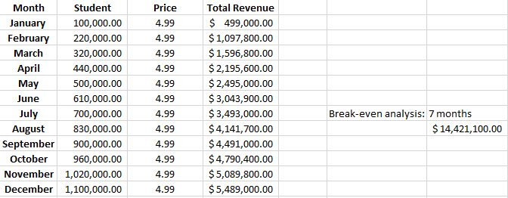
BREAKEVEN ANALYSIS
29 |

Slide 30
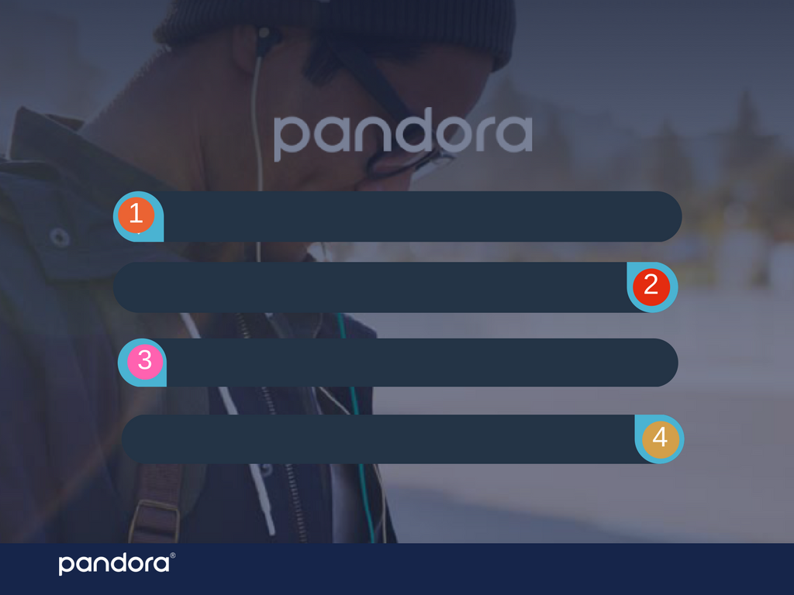
Problem Statement: We believe Pandora has a value problem for a large portion of the market (college students).
Marketing recommendation: College discount application ($4.99). This will also include incentives with our reward program.
Implementation: Realistically, a 21.5% increase in new user subscription revenue over the course of one calendar year.
Financial Analysis: (28.5 - 15) / 15 = .9 → 90% ROI
30 |

Slide 31

QUESTIONS?
THANK YOU!
31 |

